Slide 1
Battery Management System based on Cloud Computing
Mohamed Elsyed

Slide 2
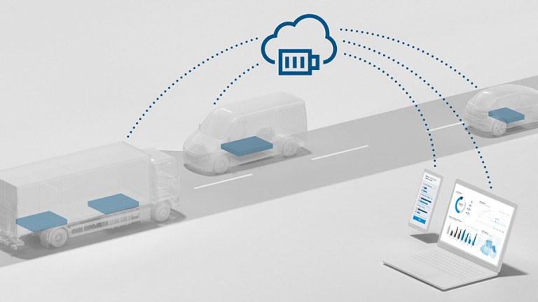
Agenda
Achieved work.
Next task.

Slide 3
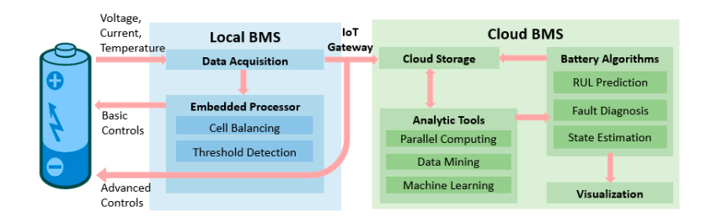
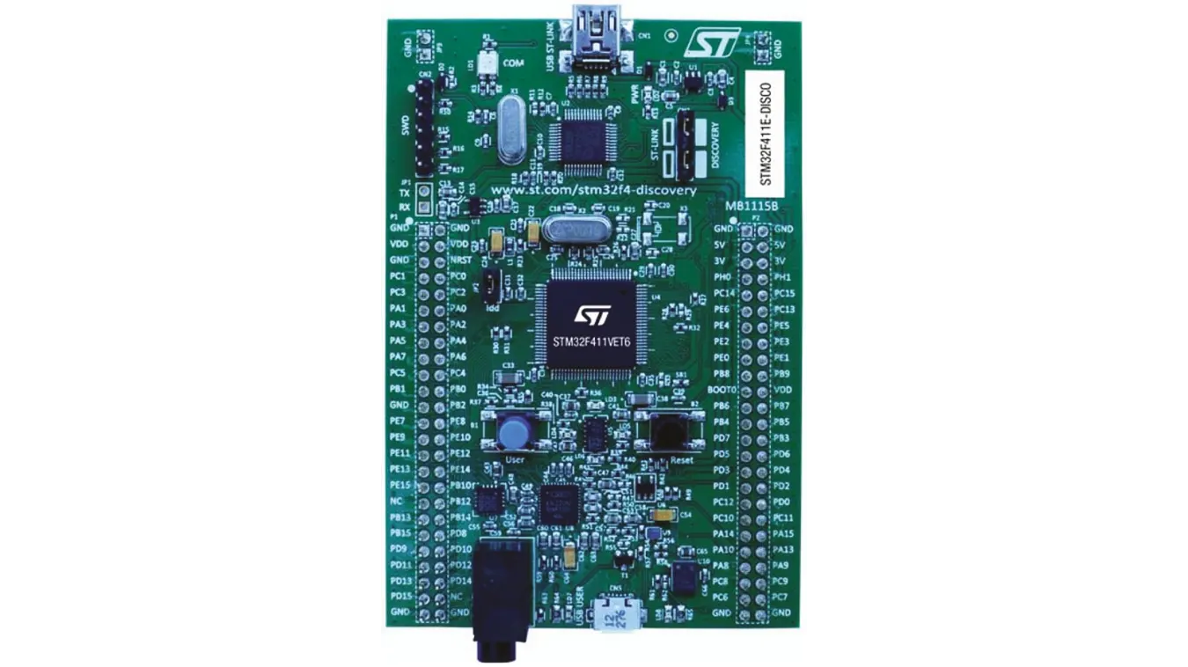
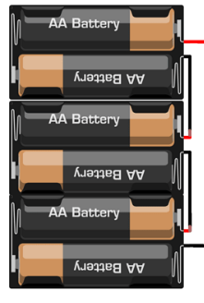
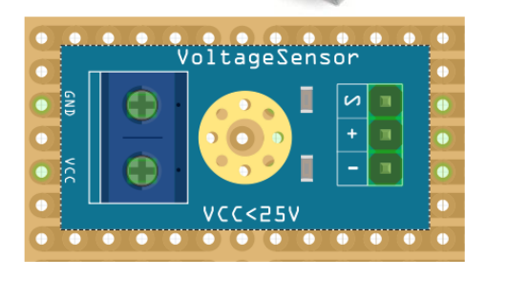
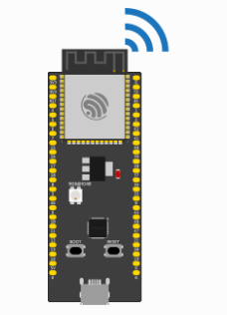
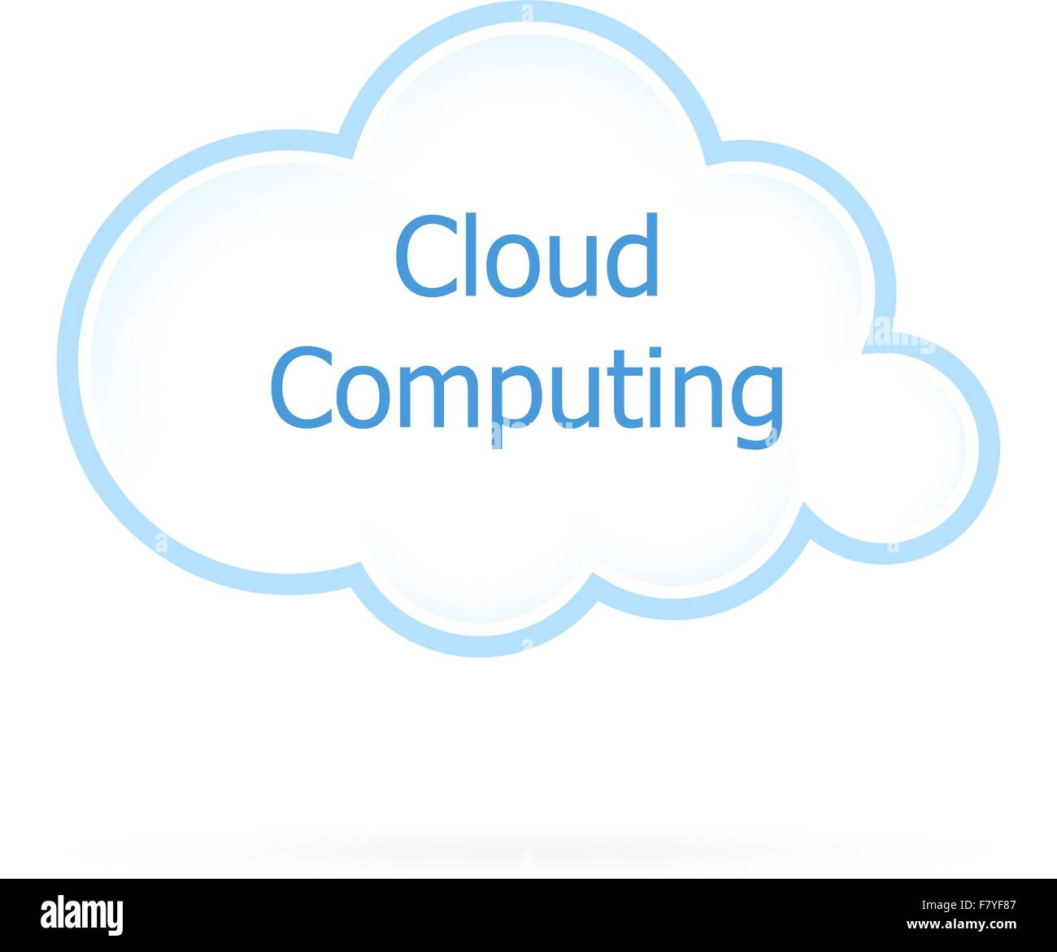

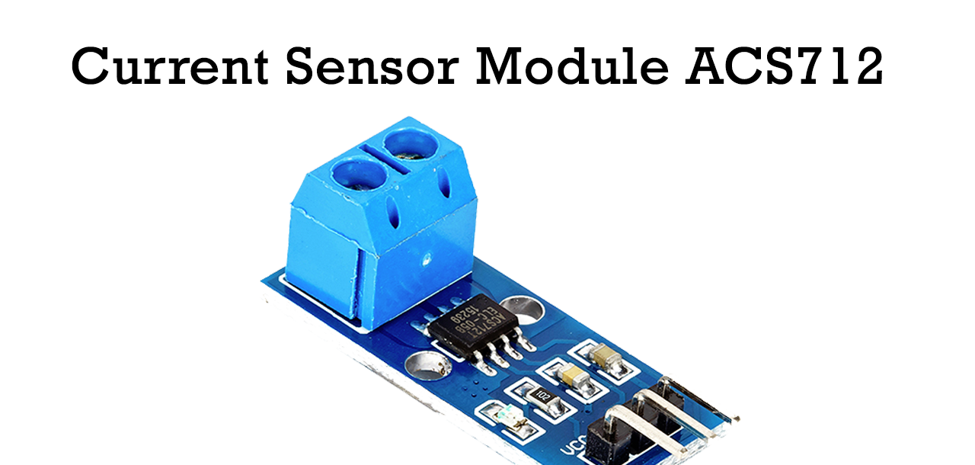

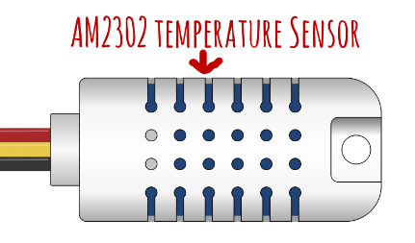
Could battery management
communication protocol

Slide 4
Timeline
Sensors Readings
Getting temperature, voltage, and current sensors readings using STM32-microcontroller.
Transmitting the read values to ESP32
Transmit the sensor reading values from STM32 to ESP32 using UART protocol.
Cloud python code
Create the cloud code using PAHO library.
Connect, subscribe, and get messages
- Connect to the broker.
- subscribe to the required topics.
- Receiving sensor measurements.
Next :………
Publish the voltage current and temperature sensors reading. Subscribe to another topics.
Next :………
Publish the voltage current and temperature sensors reading. Subscribe to another topics.
SOH computing
- Compute the

Slide 5
What could battery management is.

Slide 6
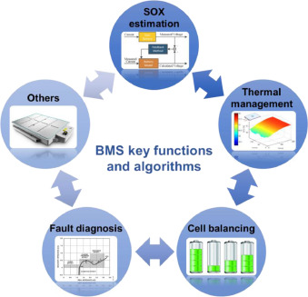
Could battery management

Slide 7
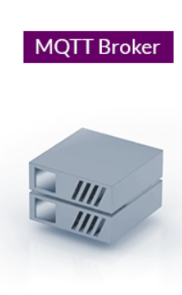



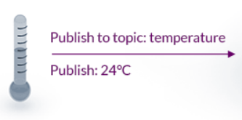
Message Queuing Telemetry Transport(MQTT):
Machine to machine network protocol.
Bi-directional Communications (publish-subscribe).
Scale to Millions of Things.
Broker and many clients
subscribe to topic: temperature
subscribe: 24°C
subscribe to topic: Fan
subscribe: Fan ON
subscribe to topic: temperature
subscribe: 24°C
subscribe to topic: Fan
subscribe: Fan ON
Publish to topic: Fan
Publish: Fan ON

Slide 8
Achieved work.

Slide 9

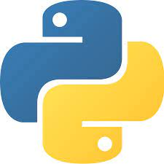



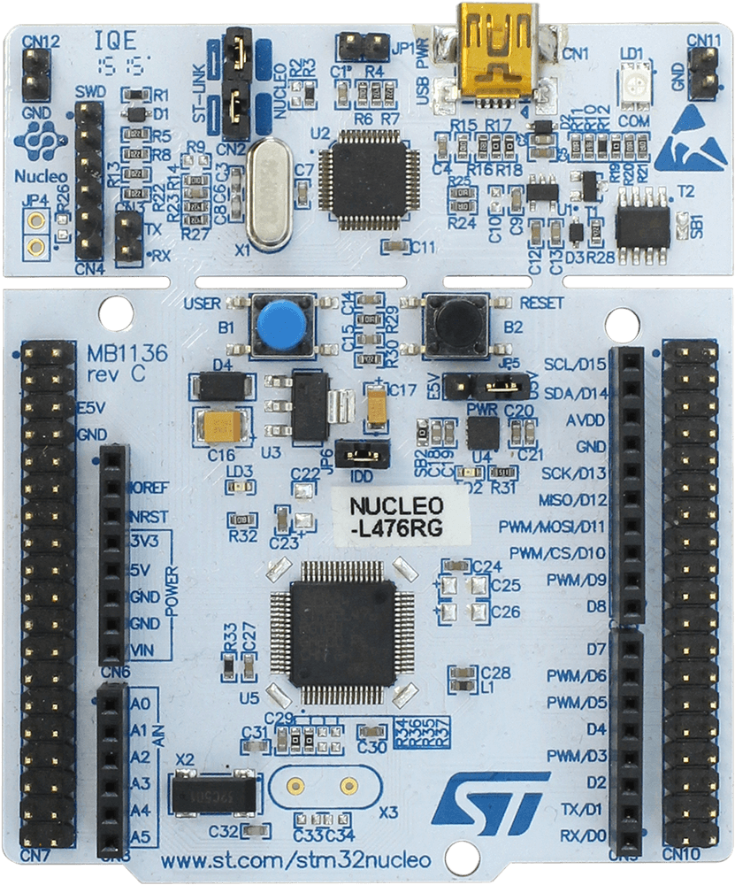


The used programing languages
Why to many Programming languages:
Every languages is the easiest way to run on its environment e.g. python for Cloud.
For me, to learn more.

Slide 10




Thank you

